Slide 1

CIR project “BabyRobot”
Eric Cañas Tarrasón
Alba María García García

Slide 2
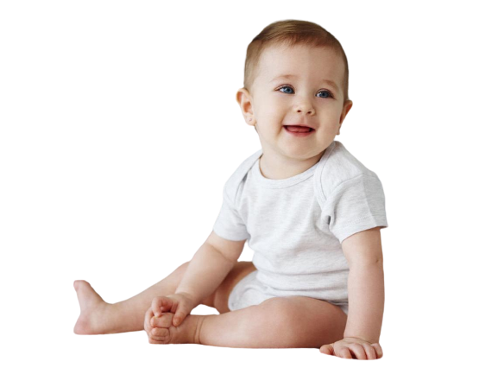
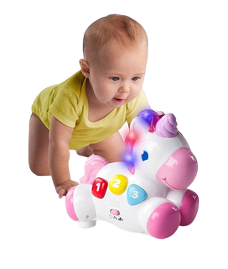

Problem definition
Without motivation to crawl
With motivation to crawl

Slide 3
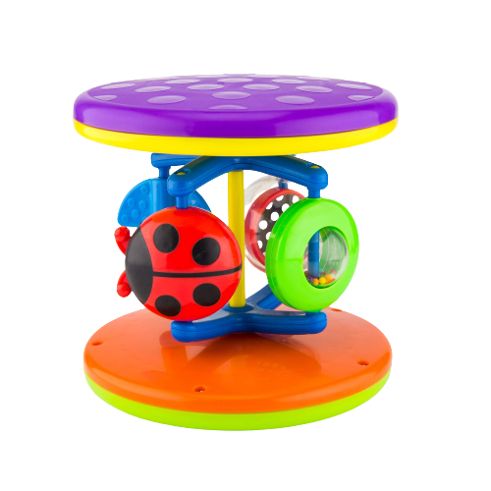


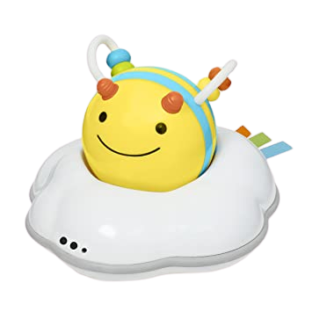
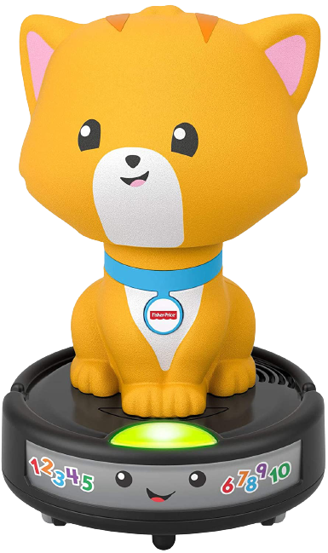

Existing solutions
Focused on aesthetics: sounds, lights, bright colors and soft materials.
Great differences regarding functionality:
Simple mechanical movements
Press & go
Autonomous simple trajectories
No complex trajectories based on the environment

Slide 4
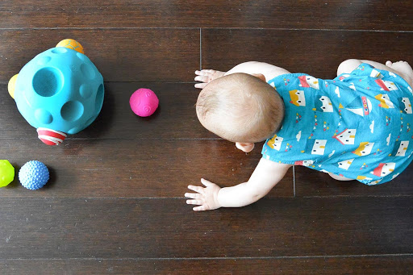
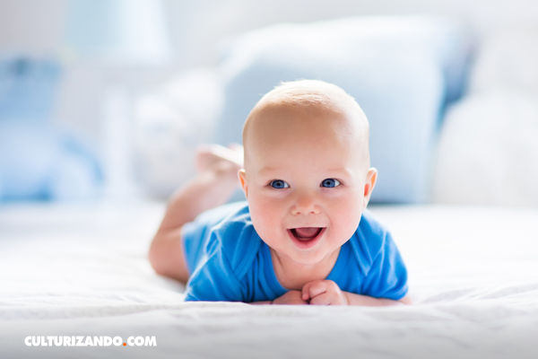
Obstacle avoidance
Min distance
George
Escaping from the baby

Slide 5

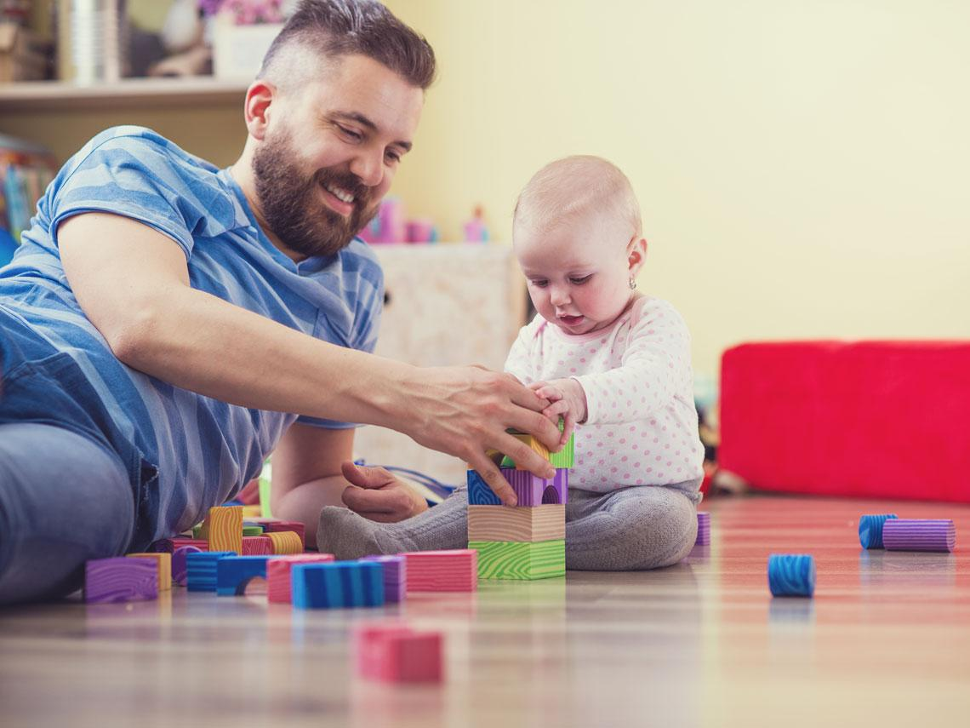



Context
Baby
Educational purpose
Oriented to secure spaces like homes or kindergartens
Adult
Robot

Slide 6

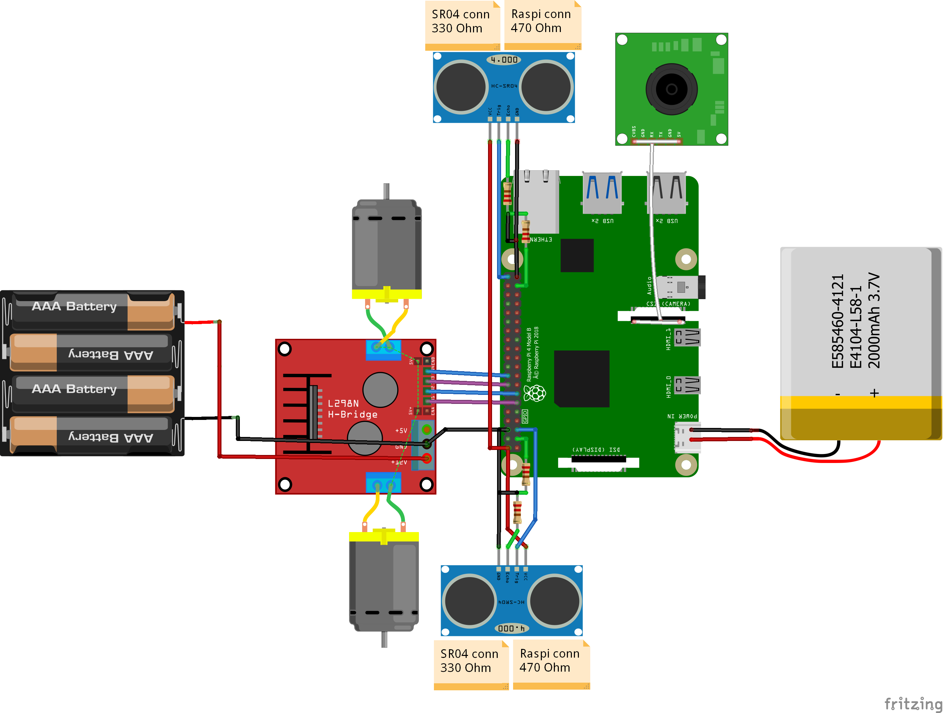
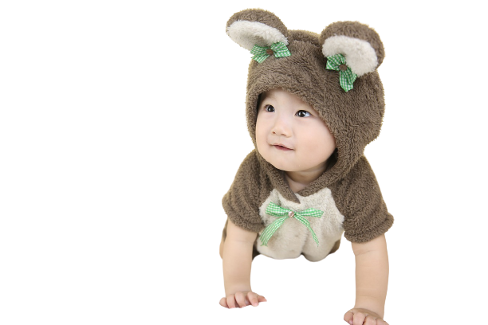

(Optionally) Send images to device
Hardware
Speeds up the process
Stream video of the session
Return the distances processed

Slide 7
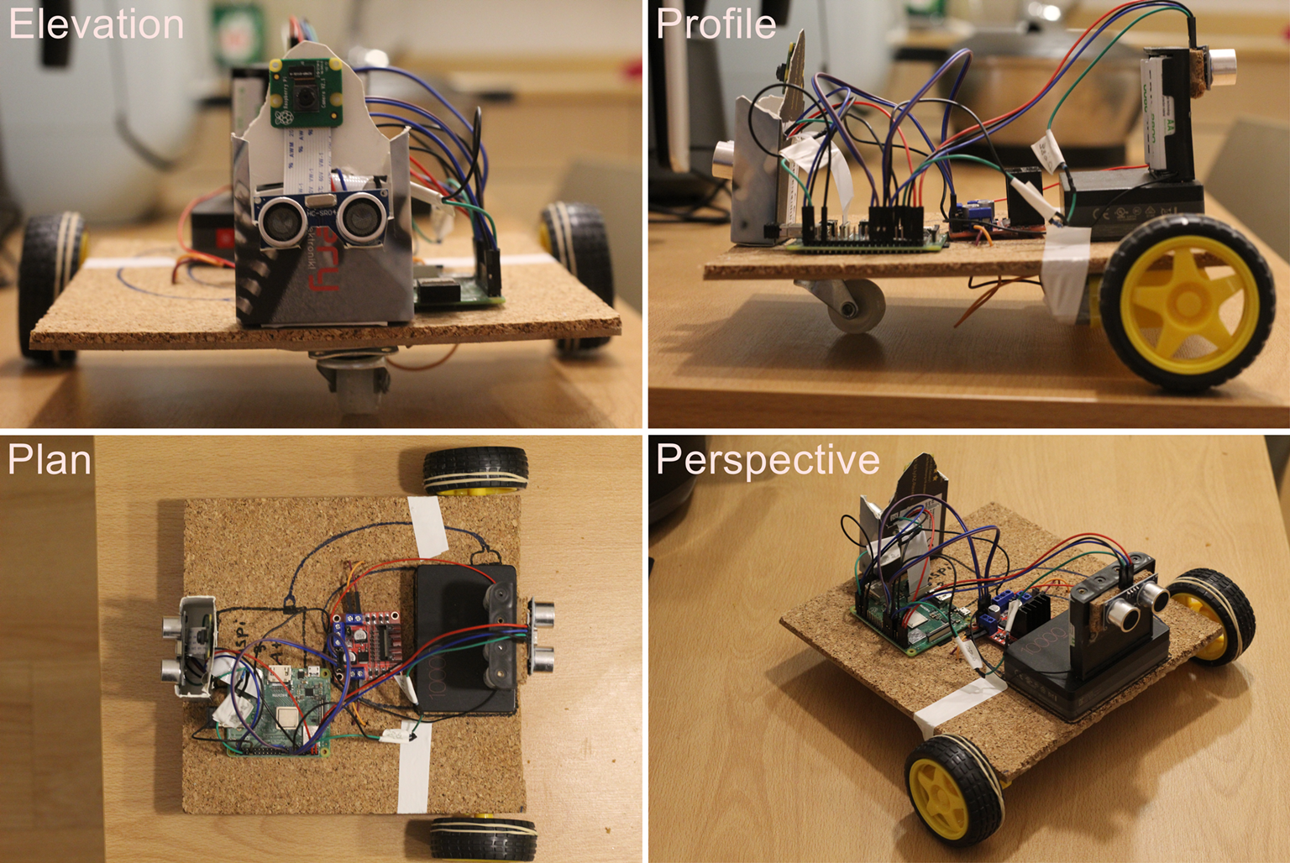
Cheap
< 80$
Robust

Slide 8
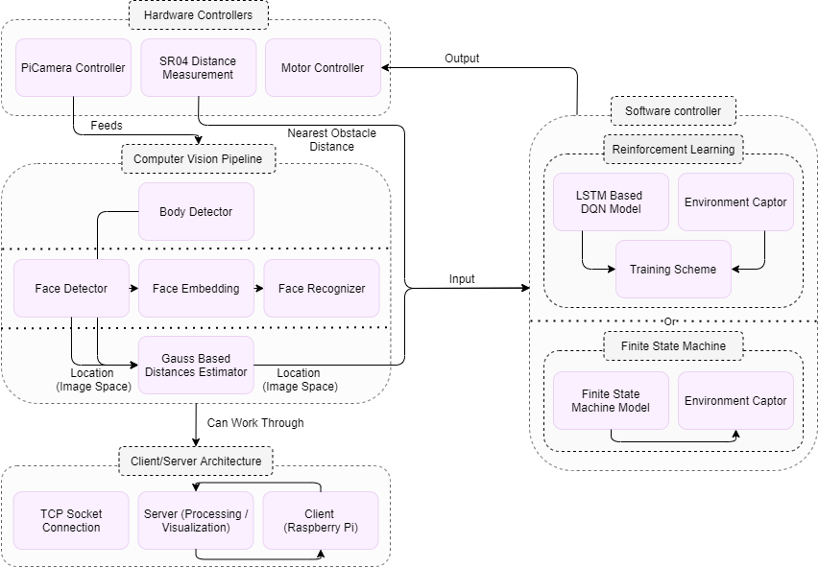
Software

Slide 9
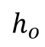
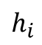

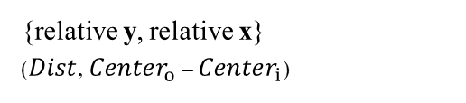
Computer Vision pipeline
Baby
If it fails
Body Detection
$$h_{i}$$
B-Plan
{relative y, relative x}
($Dist$, ${Center}_{o}$ – ${Center}_{i}$)
Face detection
OpenCV
Face detector
Output
$$\frac{Dist}{ focal}=\frac{h_{i}+h_{o}}{h_{o}}$$
Optional Identification
$$h_{o}$$
Peter
0 | 1 | 2 | … | 128
128-d Features Embedder
PCA + MLP

Slide 10
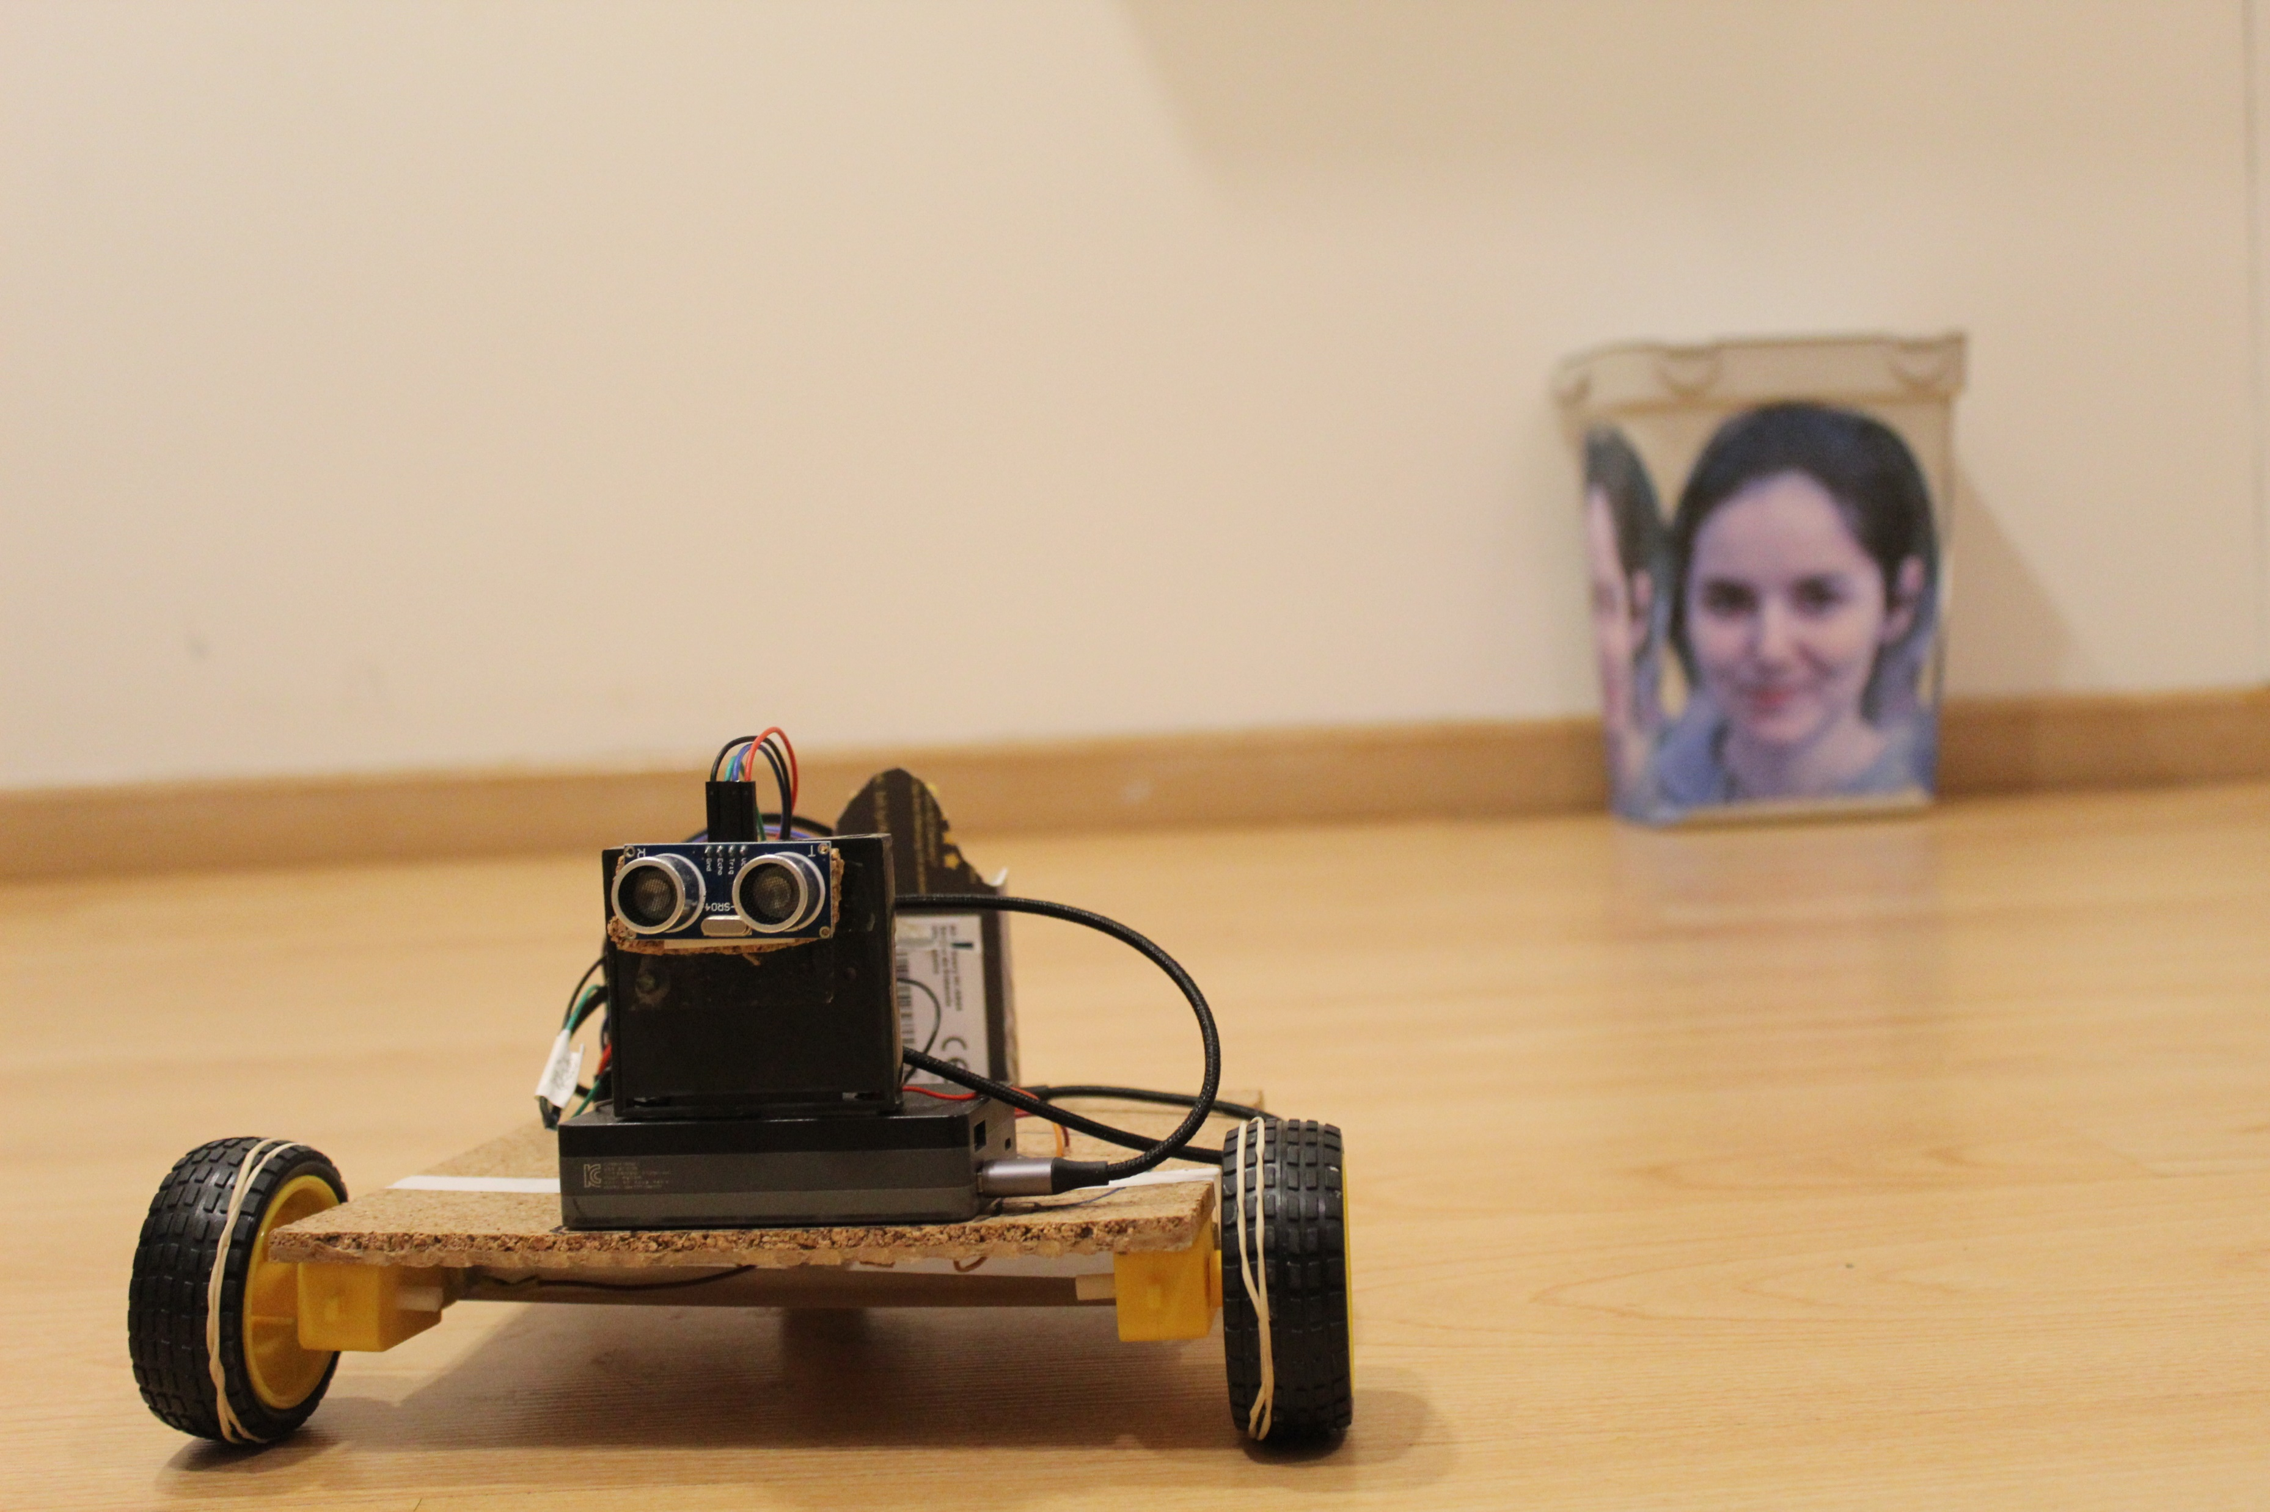
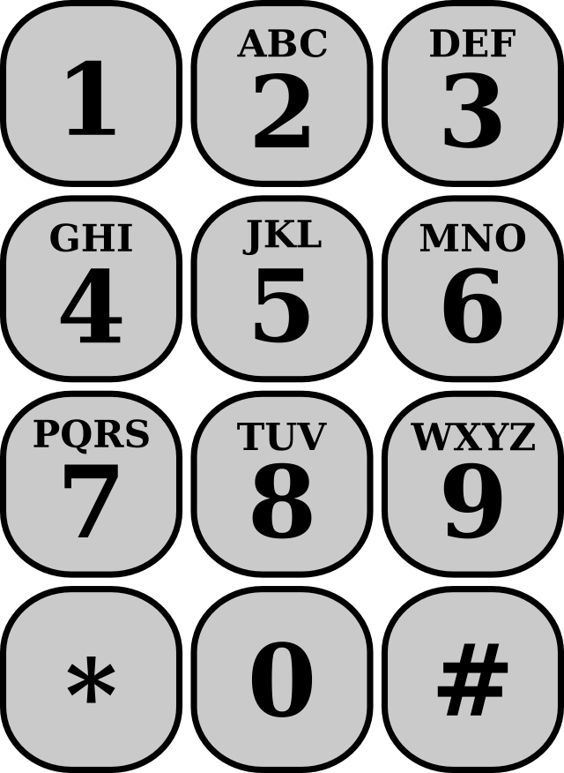
Action space
Concat Steps
$$x_{1}$$ | $$y_{1}$$ | $${Sensors}_{1}$$ | $${Act}_{1}$$ | … | $$x_{n}$$ | $$y_{n}$$ | $${Sensors}_{n}$$
LSTM DQN
$$Q_{a_{1}}$$ | $$Q_{a_{2}}$$ | $$Q_{a_{3}}$$ | $$Q_{a_{4}}$$ | $$Q_{a_{5}}$$ | $$Q_{a_{6}}$$ | $$Q_{a_{7}}$$ | $$Q_{a_{8}}$$ | $$Q_{a_{9}}$$
Teleoperated
exploration
Reinforcement
Learning controller

Slide 11
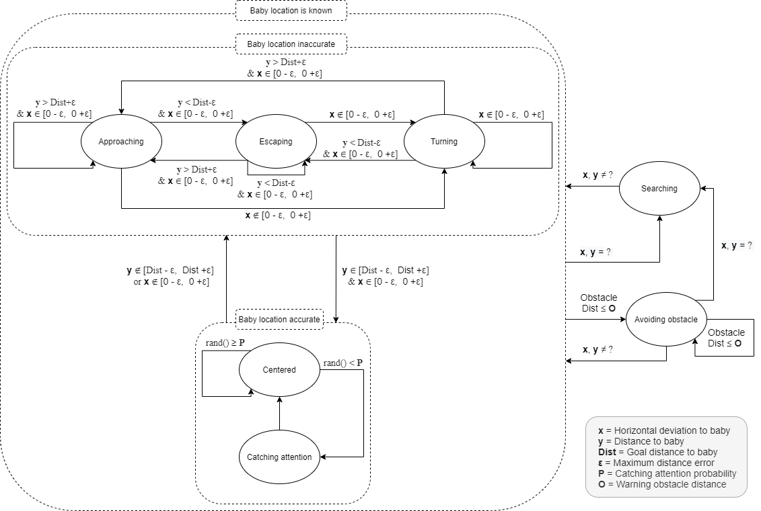
Finite State Machine

Slide 12
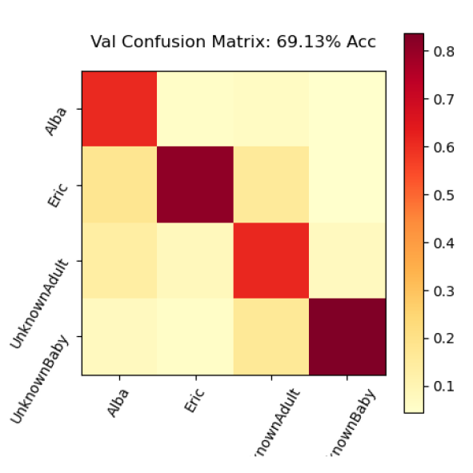
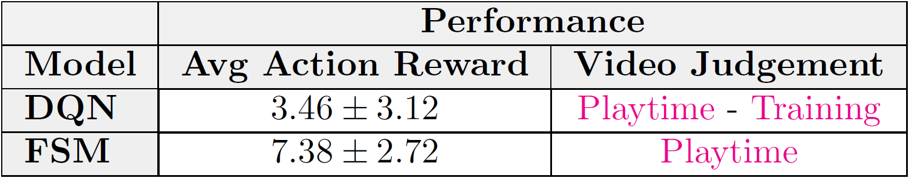
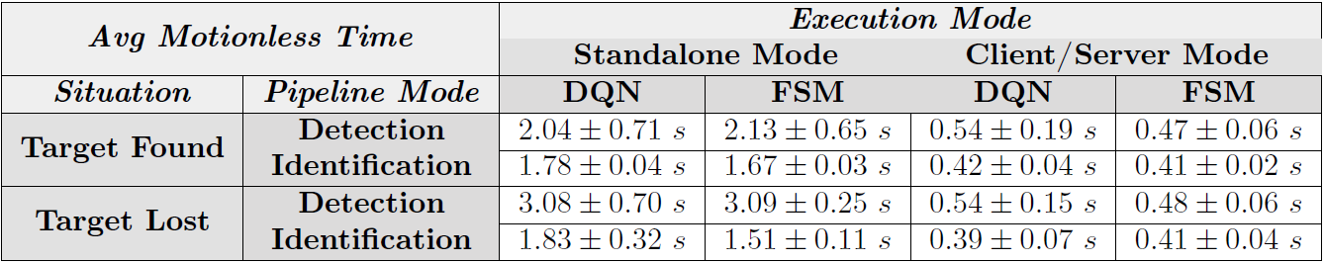

Quality criteria for system performance
Identification accuracy
Average motionless time
Average action reward

Slide 13

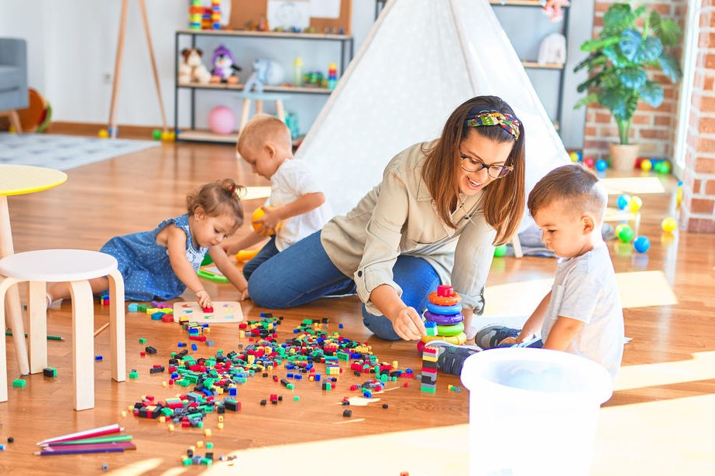



Experimentation setup
At a kindergarten
Group of 6 infants of around 12 months old
Experiment lead by the caregiver of the group
Using homologated toys rather than “BabyRobot”

Slide 14


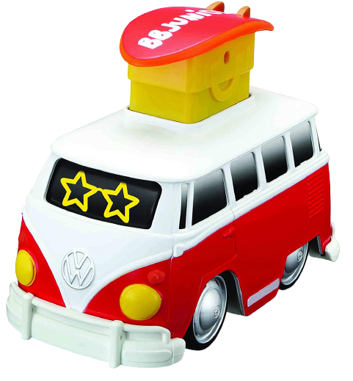
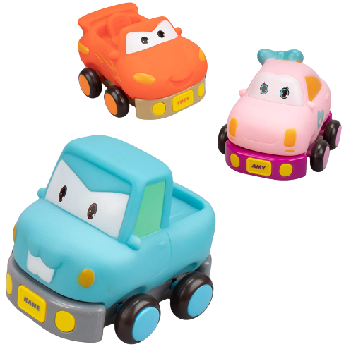
Evaluation of the experimentation
Control condition
No crawling toys
Mobility
Crawling toy condition
Press & go + teleoperated toy
Behavior

Slide 15
Results
Control condition
Crawling toy condition
Most common behavior.
To walk around carrying a toy
Changes in behavior.
Great enthusiasm and interest for the new toys but also many fights to play with them.
Babies crawl frequently to chase the toys.
Many time spent understanding the toys’ functioning.
Mobility around 65%.
Inconclusive results
Lower mobility (around 32%).

Slide 16

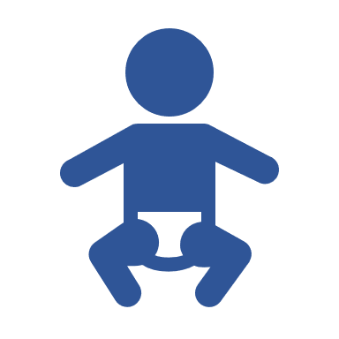
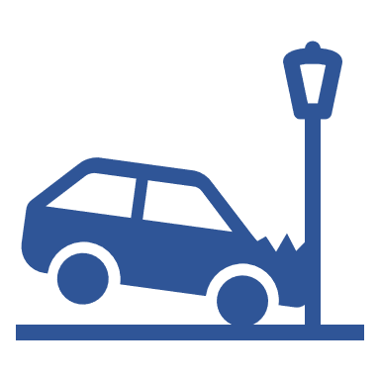
Conclusions
Further experimentation is needed…
But there is also a lot of work to do on “BabyRobot”:
To look for a design appealing to babies.
To add new modes for different locomotion stages.
To include a way to recover from overturns.

Slide 17
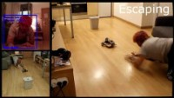

Slide 18

Notes:
Any question?

